Slide 1
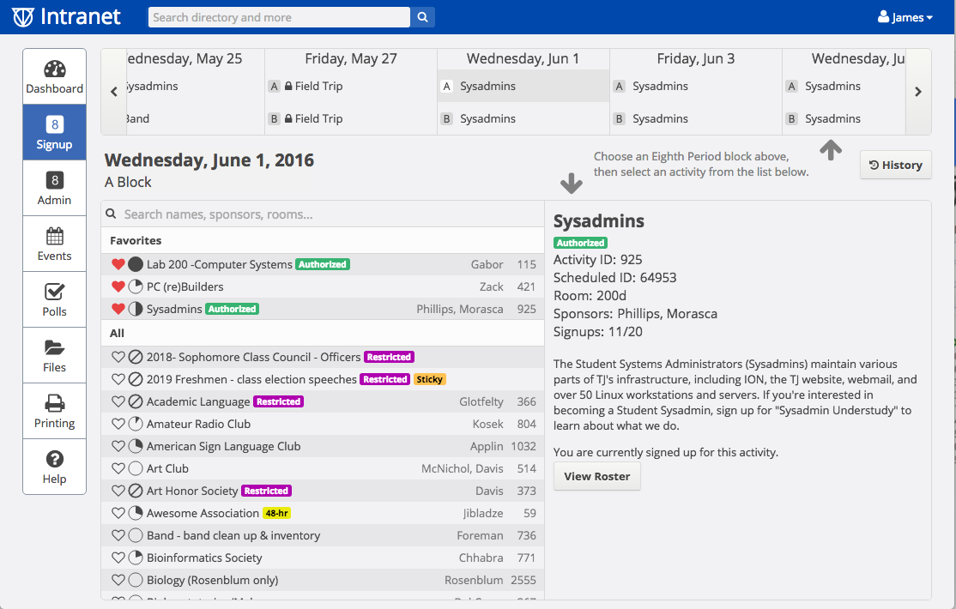
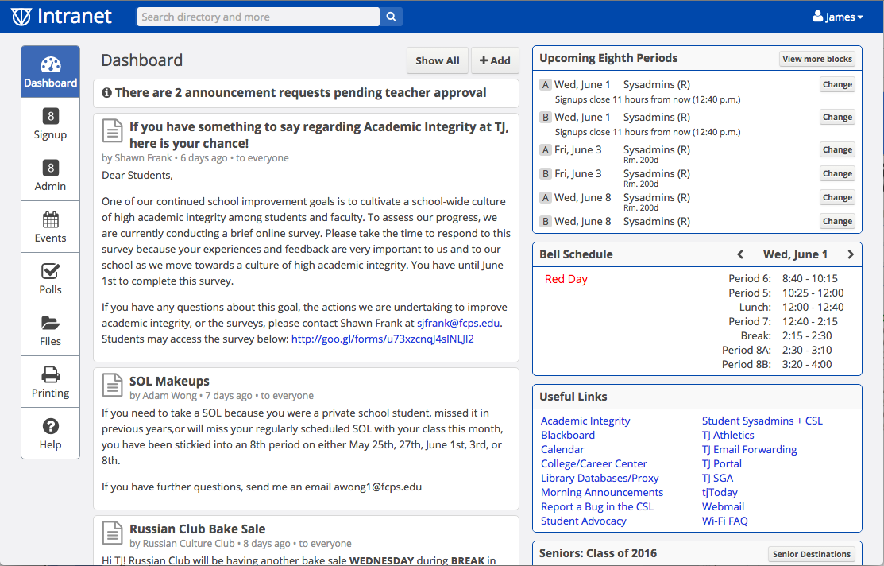
A Web-Based Intranet Platform for TJHSST
TJ Intranet 3: Ion
James Woglom
Computer Systems Research Lab
2015–2016, Period 3
Background
Since the late 1990s, TJ has used various different systems to manage student signups, teacher attendance, and staff administration of the Eighth Period activity system. Although the modern TJ Intranet has many more functions, the Intranet system has always been focused around the Eighth Period component.
Beginning with the original Intranet application launched during the school year of 1999, this system was web-based and available to all students. Prior to the web-based student Intranet, TJ used a custom solution involving commercial computer database software combined with scripts to read signups from pencil-and-paper Scantron sheets, that were imported into commercial database software.
The original web-based Intranet software was written in PHP using the MySQL database, and suffered from many problems due to its poor architecture. It was designed in the late 90s and early 2000s using a new programming language, PHP 4, in an era where there were few standards for web programming. As a result, the application quickly became outdated and unmaintainable. In 2004, a project began to rewrite Intranet using modern PHP and object oriented programming known as Intranet2, codenamed Iodine. When it launched in 2006, it demonstrated the importance of passing down the Intranet application from year to year in order for it to remain in capable hands and be properly maintained. Over its lifetime, Iodine was expanded with numerous new features, and its object-oriented structure allowed for the Intranet application to actually be updated and enhanced upon as time went on. However, after continued use at TJ for nearly a decade, intermittent speed, efficiency, and code quality issues led to demand for a new system both developed with current technology and designed for modern devices.
Process
Intranet 3 (Ion) development began in mid-2013 by current Intranet2 maintainers Ethan Lowman (TJ 2015) and James Woglom (TJ 2016). The application was planned very early on to be Python-based because of the vast library support and stability that the language provides, and because Python is the preferred programming language for many Computer Science classes taught at TJ such as Artificial Intelligence and Accelerated CS.
The Django web framework is at the core of Intranet’s architecture, and was chosen because of its emphasis on clean and pragmatic design and code structure. Django includes many built-in features, such as an administrative interface, object-relational mapper for database queries, user model and basic user authentication, and templating engine, which both work well together and allow for less custom code to be required. The separation of code into separate pluggable apps also allows for the application to be better structured and discourages code duplication. All apps use the model-view-controller framework, in which database models define how the database is structured using Python classes, views describe and run the code to be passed into HTML templates using a templating engine, and controllers such as the URL dispatcher deal with routing and serving files. The Django project is also well established, having been originally developed over a decade ago and now in use by many large companies, including Tumblr, Pinterest, and Bitbucket.
While a majority of backend infrastructure code was completed by the end of school year 2015, Ion launched in mid-November in order to allow for beta testing and feedback collection from students, teachers, and administrators. A three-day switchover occurred from Iodine beginning November 13th, and Ion launched publicly to all students on the 16th and successfully ran its first eighth period day on the 18th. Like previous versions of the TJ Intranet, Ion will be continually developed by students in order to keep the application as modern and adaptive to new technologies and methods as possible, and to continue its use as a learning tool and real-world example of custom software found in business and other enterprise environments.
Rationale
Planning for a full rewrite of Iodine began after a gap in Intranet developers for several years resulted in there being no current students who understood to a high degree how Iodine worked. The decaying quality and aging of the codebase, of which development had begun nearly 9 years earlier, also resulted in constant small problems spread throughout the application that seemed unfixable. The most noticeable issue for the student and teacher population was its poor speed and reliability as a modern web application. The backend PHP code, while object-oriented and using a class-based structure, required excessive server-side computation to occur on each page load, often going over 1,000 separate MySQL queries per page per user. The homebrewed nature in which the database was accessed meant that lots of individual database tasks that could be combined into a single and more optimized query were instead found individually, resulting in slower load times and race conditions.
The largest technological change that occurred during Iodine’s lifespan, which it struggled to fully adapt to, was the emergence of smartphones and mobile devices. As more and more students began bringing smartphones to school, Iodine started to be used more and more frequently at all hours of the day, as opposed to just during lunch, breaks, and eighth period. This increased amount of load, coupled with the backend inefficiencies, resulted in Intranet often being completely inaccessible during peak times. Intranet2’s front-end, which was designed for desktop browsers circa 2005, quickly became cluttered and archaic. Additional CSS themes were later added to bring Iodine’s design up to par and offer some support for mobile layouts in 2012, but the application’s core structure was still not optimized for mobile devices first. A very limited and homebrewed XML-based API also made creating third-party applications difficult.

